Slide 1
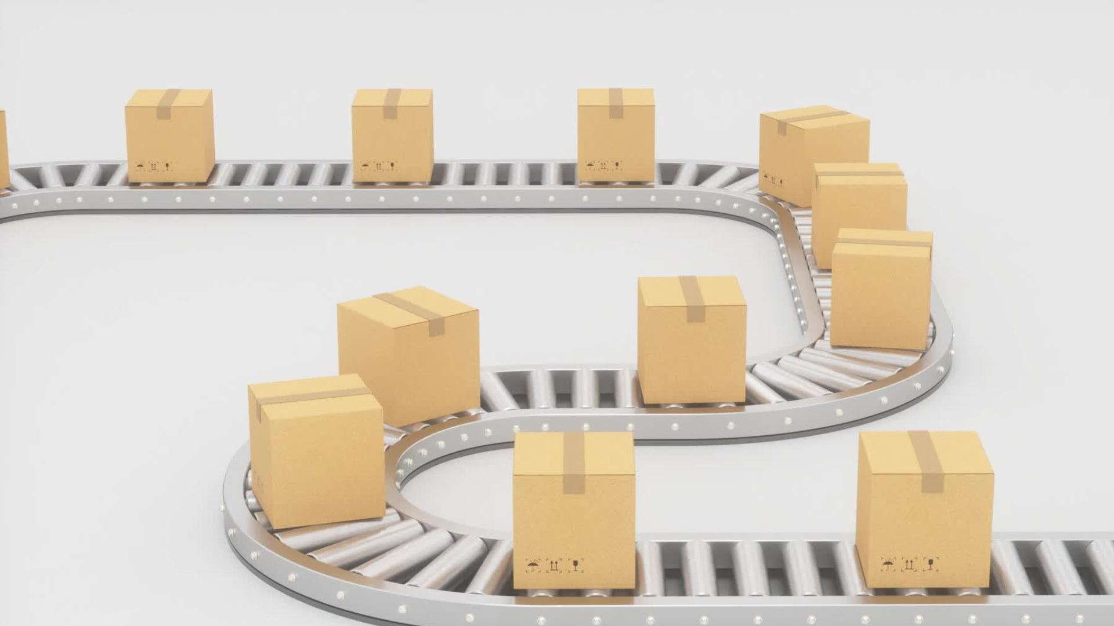
Delivery Optimizer
25 April 2022

Slide 2
Team
Shem Freddy Pereira
Tina Jacob
Ziyad El Amrani-Joutey
Harsh Gupta
Robin Manchanda

Slide 3

Introduction
Age of online shopping
Customer and order count drastically increased
Tight market competition
Delays in deliveries result in unhappy customers

Slide 4

Problem Statement
In order to avoid delivery delays, a balance must be maintained when estimating the delivery date. If a customer places an order and receives an estimated delivery date, it must be fulfilled on or before the estimated delivery date that was provided with out losing the sale.
Goal
To create a model capable of estimating the delivery time which is accurate and competitive so that the customer experience is enhanced.

Slide 5

Dataset
Input features
Order-Date: date in format YYYY-MM-DD
Delivery-Date: date in format YYYY-MM-DD
Promised-Date: date in format YYYY-MM-DD
Courier: Name of the courier
Size of the box height: Height of the box in cm
Size of the box width: Width of the box in cm
Size of the box length: Length of the box in cm
Size of the box weight: Weight of the parcel in Kg
Weather condition: Good, Bad
Store address: Address of the store the orders were shipped from; longitude/latitude
Customer address: Address delivery; longitude/latitude

Slide 6

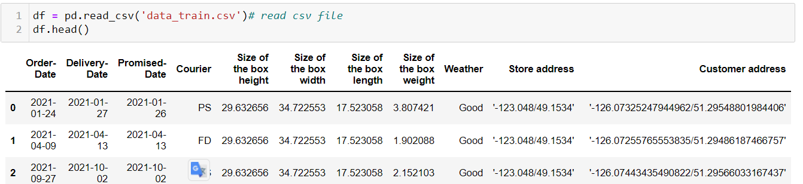
Dataset

Slide 7
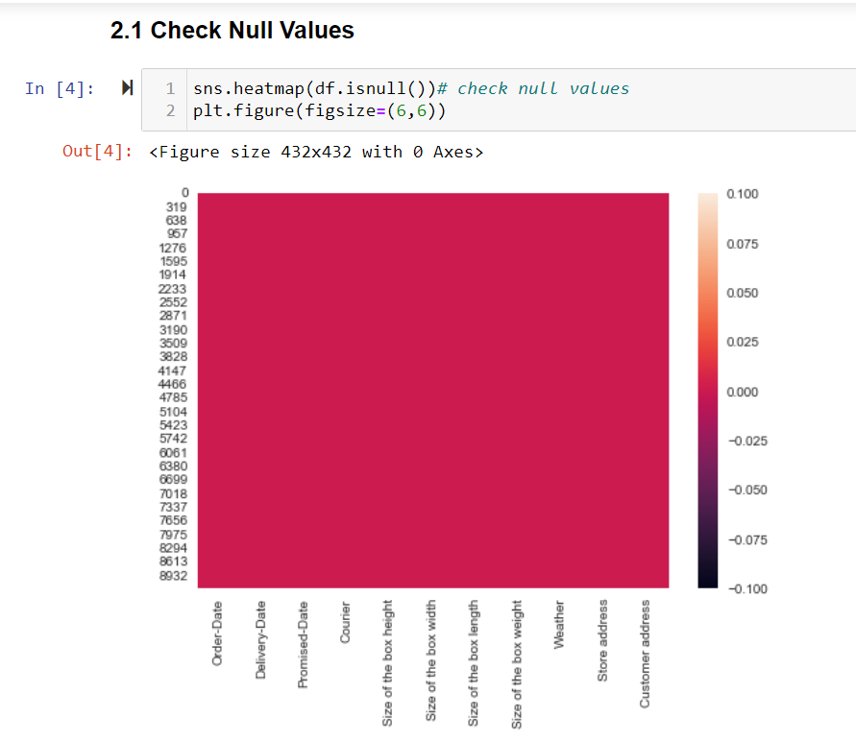
Dataset
There are no null values in the dataset.

Slide 8

Feature Engineering
The dataset has certain features, such as customer address, store address, order date, promised date, etc., that cannot be used directly as an input to the machine learning model.
Some of the features are engineered and some new features have been created and these are explained below:
Distance: It represents the distance between customer and store address.
All the dates have been changed to pandas DateTime object
Shipping_days (Target Label): It is the number required to ship the product to the customer.
Order_month: To find the effect of the month on the shipping days.

Slide 9
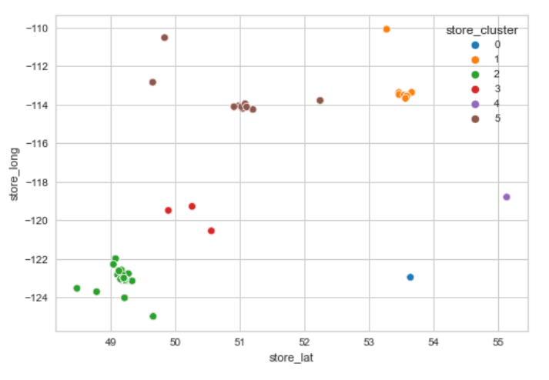
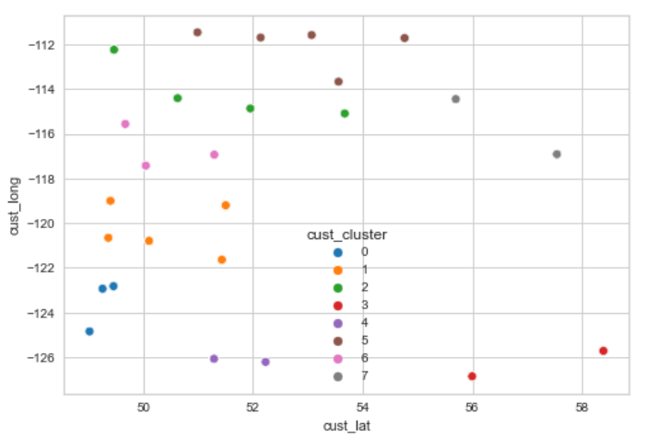
Feature Engineering
Latitude and longitude can't be used directly, used k-means to convert them to clusters

Slide 10
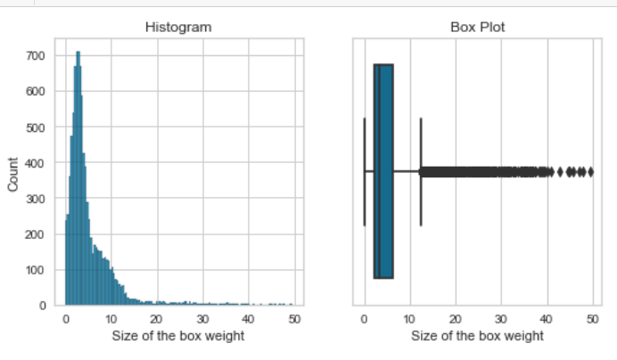
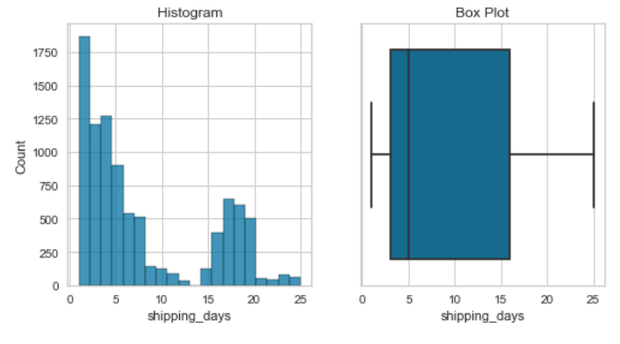
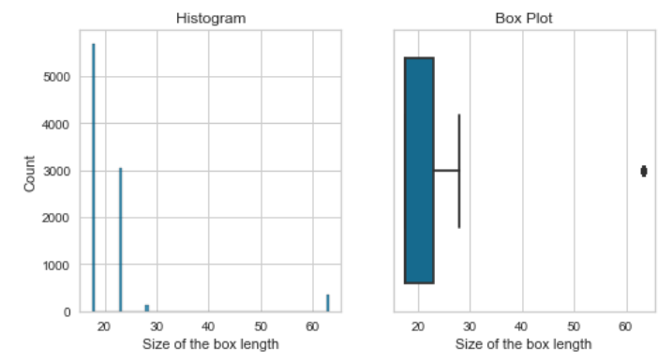
EDA
Robust Scaler is used in the next part of the notebook to deal with the outliers.

Slide 11
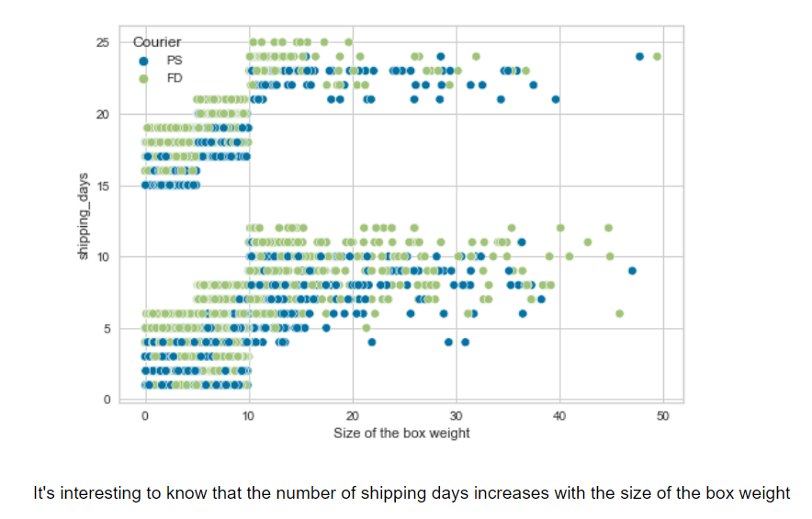
EDA
It's interesting to know that the number of shipping days increases with the size of the box weight

Slide 12
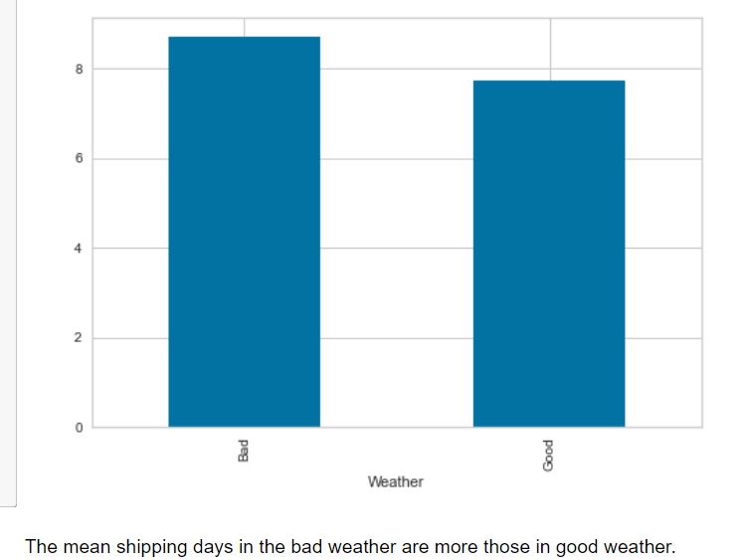
EDA
The mean shipping days in the bad weather are more those in good weather.

Slide 13
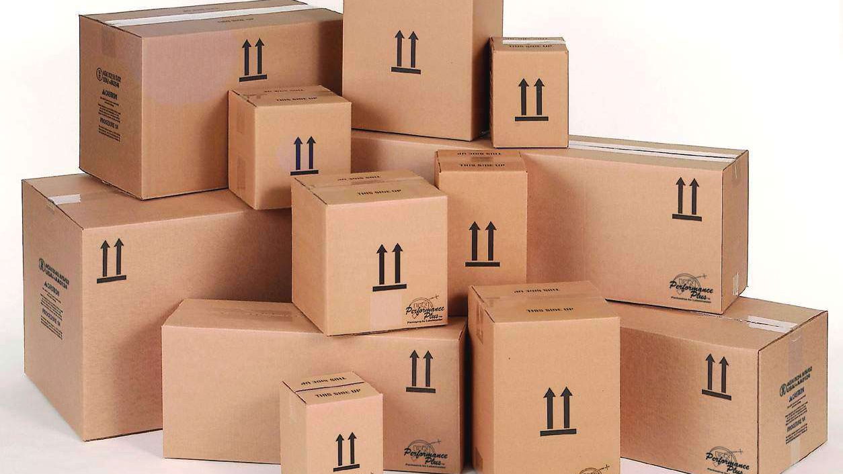
Modeling Approaches
Ridge Regression
Random forest
Neural Network

Slide 14
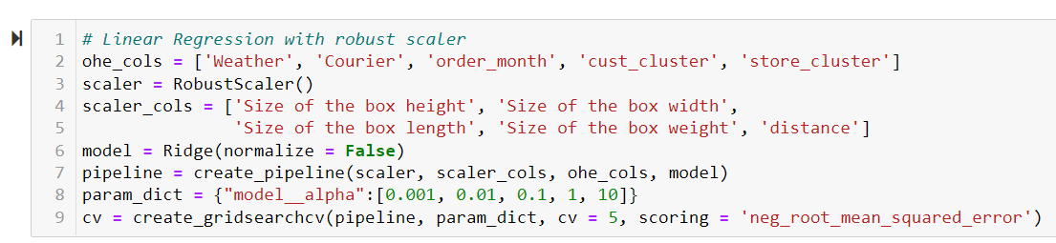
Ridge Regression

Slide 15
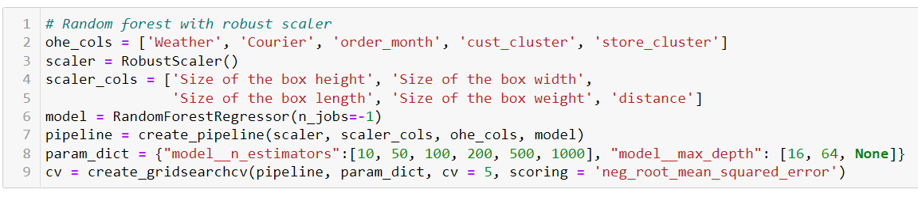
Random forest

Slide 16
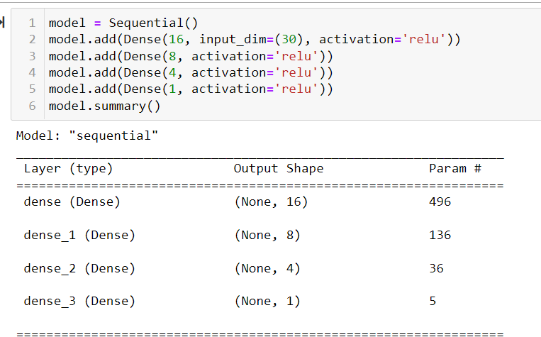
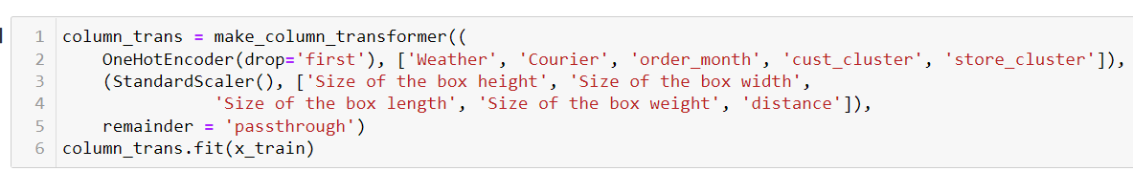
Neural Network

Slide 17
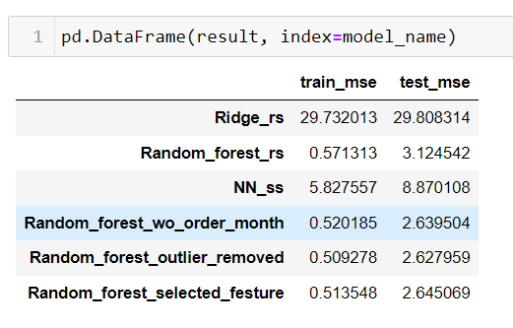
Results
Acronym used to save the space: "rs" is robust scaler & "ss" is standard scaler

Slide 18
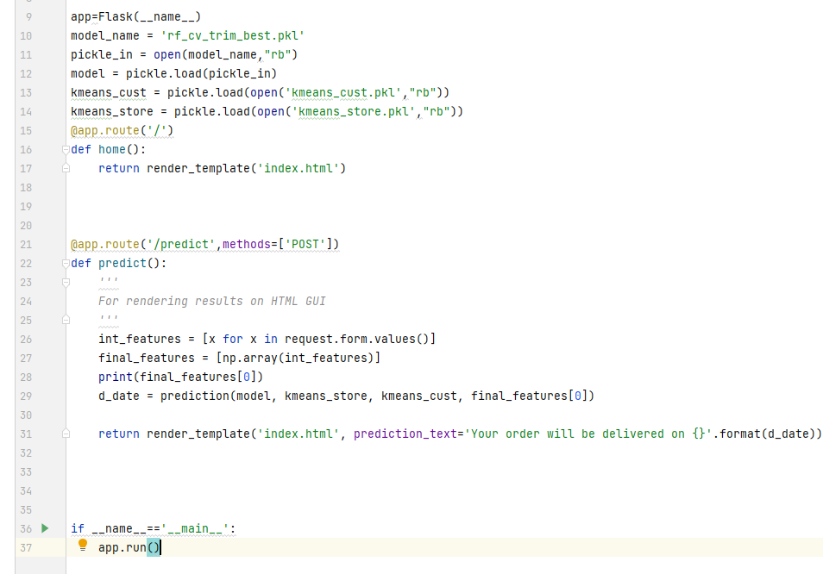
Deployment
Flask

Slide 19
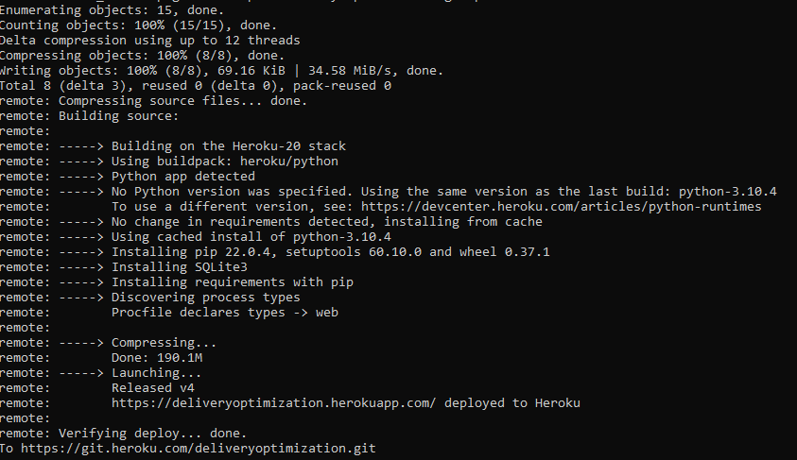
Deployment
Heroku

Slide 20
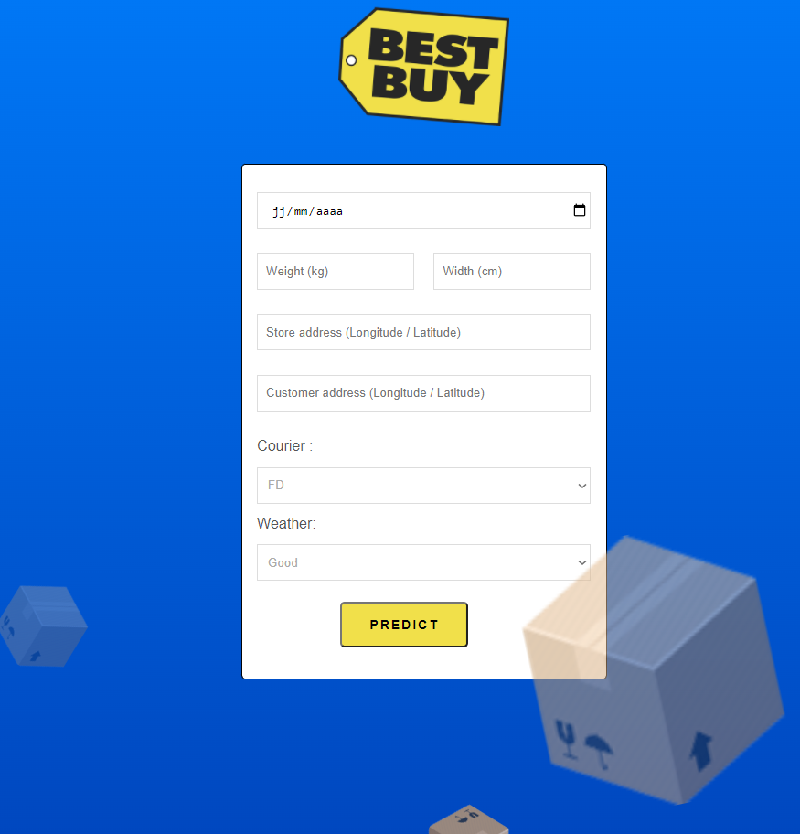
Demo
https://deliveryoptimization.herokuapp.com

Slide 21
Conclusion

